Slide 1
Car Accident Severity
By G.S.S.Shashank

Slide 2
Introduction
Road Accident is the most undesirable and unexpected thing to occur to a road user, though they happen quite often. Unfortunately, we can see a minatory rise of road accidents
In an effort to reduce the frequency of car collisions in a community, an algorithm must be developed to predict the severity of an accident given the current weather, road and visibility conditions. When conditions are bad, this model will alert drivers to remind them to be more careful.

Slide 3
Data Understanding
Our predictor or target variable will be 'SEVERITYCODE' because it is used measure the severity of an accident from 0 to 5 within the dataset. Attributes used to weigh the severity of an accident are 'WEATHER', 'ROADCOND’, 'LIGHTCOND',’ The total number of people involved in the collision’ and’ The number of vehicles involved in the collision.
Severity codes are as follows:
0 | Little to no Probability (Clear Conditions)
1 | Very Low Probability - Chance or Property Damage
2 | Low Probability - Chance of Injury
3 | Mild Probability - Chance of Serious Injury
4 | High Probability - Chance of Fatality

Slide 4
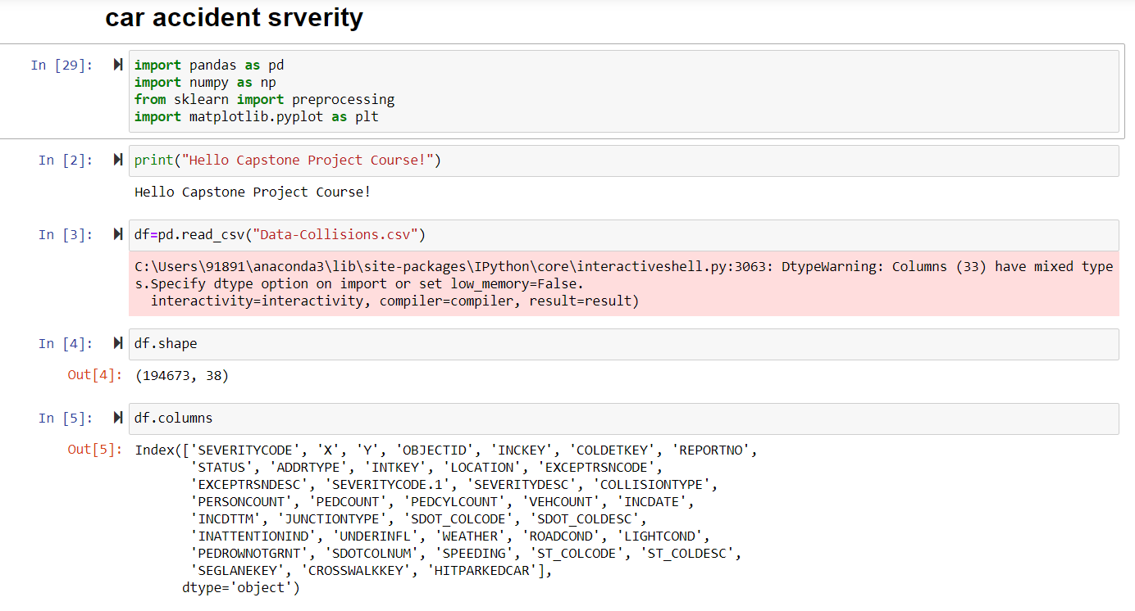
Data Pre-Processing
In it's original form, this data is not fit for analysis. For one, there are many columns that we will not use for this model. Also, most of the features are of type object, when they should be numerical type.

Slide 5
Missing Data
In Pandas missing data is represented by two value:
None: None is a Python singleton object that is often used for missing data in Python code.
Nan : Nan (an acronym for Not a Number), is a special floating-point value recognized by all systems that use the standard IEEE floating-point representation

Slide 6
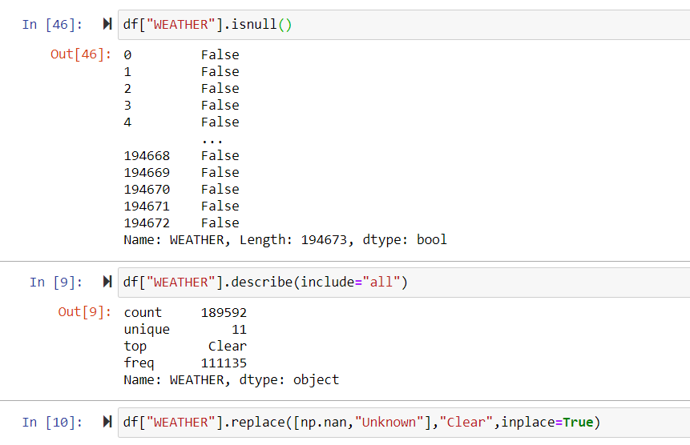

Slide 7
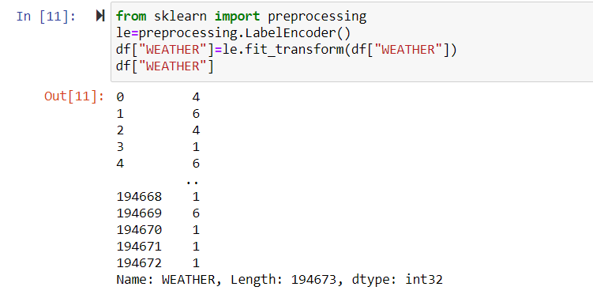
Encoding
We must use label encoding to covert the features to our desired data type. Label Encoding refers to converting the labels into numeric form so as to convert it into the machine-readable form. Machine learning algorithms can then decide in a better way on how those labels must be operated. It is an important pre-processing step for the structured dataset in supervised learning.

Slide 8
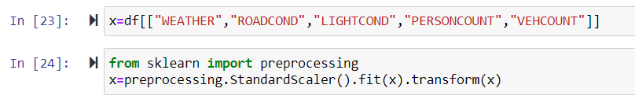
Feature Scaling
Feature Scaling is a technique to standardize the independent features present in the data in a fixed range. It is performed during the data pre-processing to handle highly varying magnitudes or values or units. If feature scaling is not done, then a machine learning algorithm tends to weigh greater values, higher and consider smaller values as the lower values, regardless of the unit of the values.

Slide 9
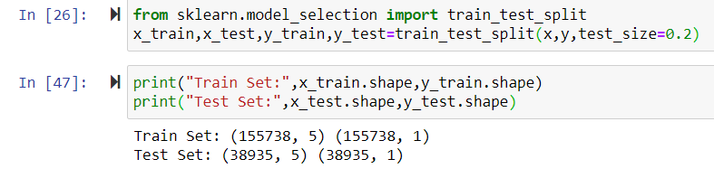
Training Data and Test Data:
Training Data:
The observations in the training set form the experience that the algorithm uses to learn. In supervised learning problems, each observation consists of an observed output variable and one or more observed input variables.
Test Data:
The test set is a set of observations used to evaluate the performance of the model using some performance metric. It is important that no observations from the training set are included in the test set.

Slide 10
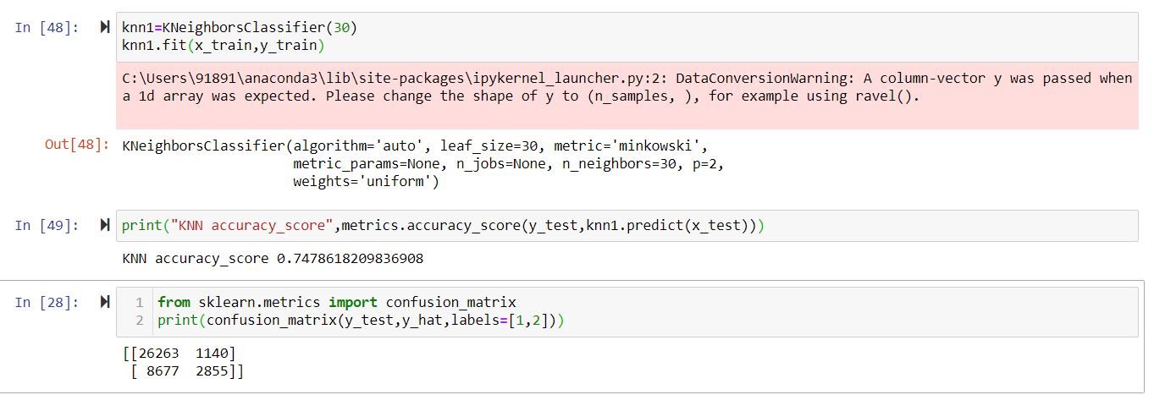
Predictive Modelling:
K-nearest neighbours (KNN):
K-nearest neighbours (KNN) algorithm is a type of supervised ML algorithm which can be used for both classification as well as regression predictive problems. However, it is mainly used for classification predictive problems in industry.

Slide 11
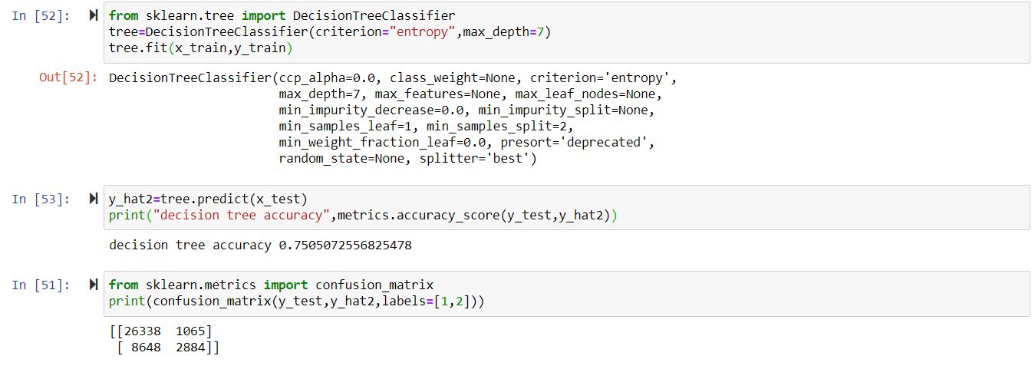
Decision Tree:
In general, Decision tree analysis is a predictive modelling tool that can be applied across many areas. Decision trees can be constructed by an algorithmic approach that can split the dataset in different ways based on different conditions. Decisions tress are the most powerful algorithms that falls under the category of supervised algorithms.

Slide 12
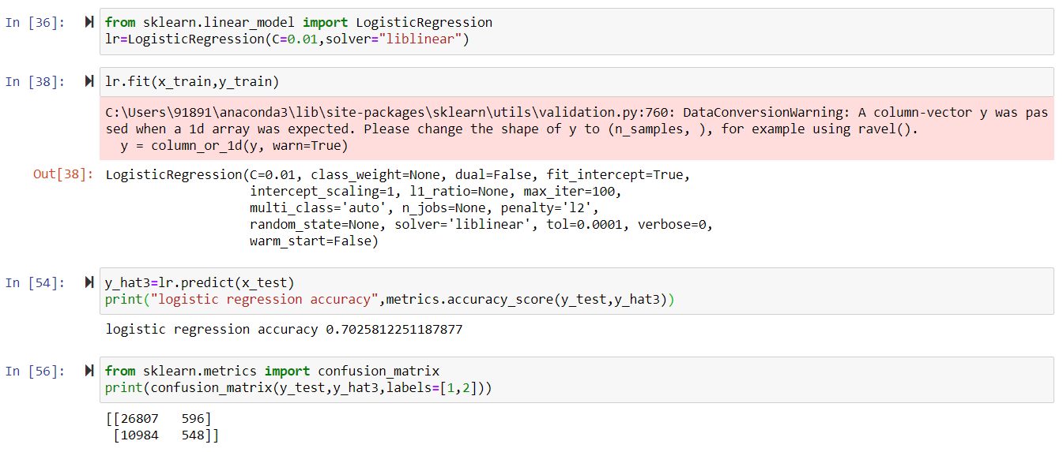
Logistic Regression:
Logistic regression is a supervised learning classification algorithm used to predict the probability of a target variable. The nature of target or dependent variable is dichotomous, which means there would be only two possible classes.

Slide 13
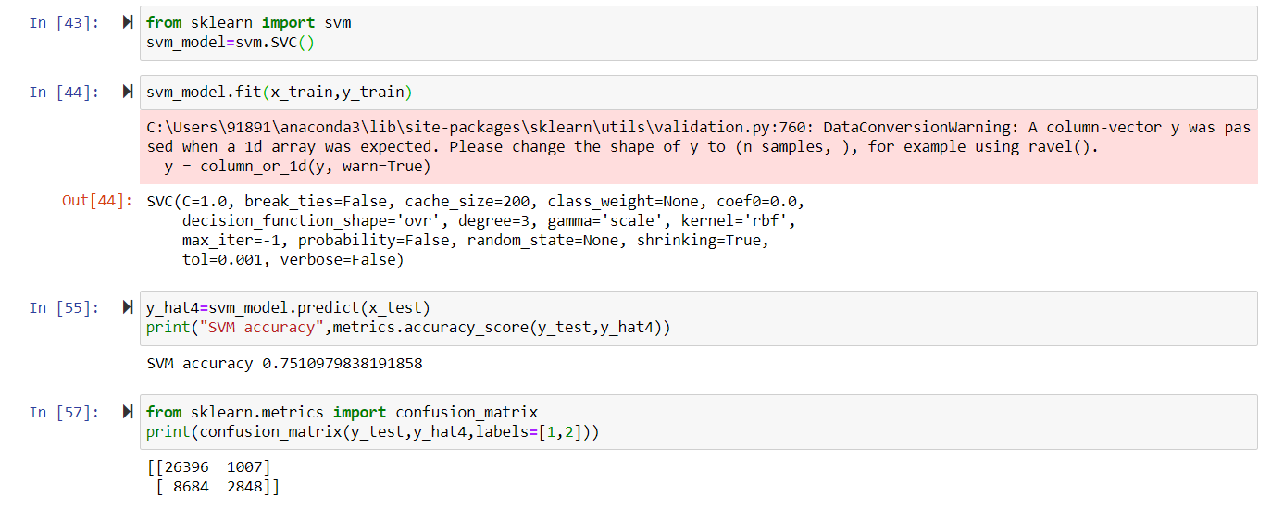
SVM:
An SVM model is basically a representation of different classes in a hyperplane in multidimensional space. The hyperplane will be generated in an iterative manner by SVM so that the error can be minimized. The goal of SVM is to divide the datasets into classes to find a maximum marginal hyperplane (MMH).

Slide 14
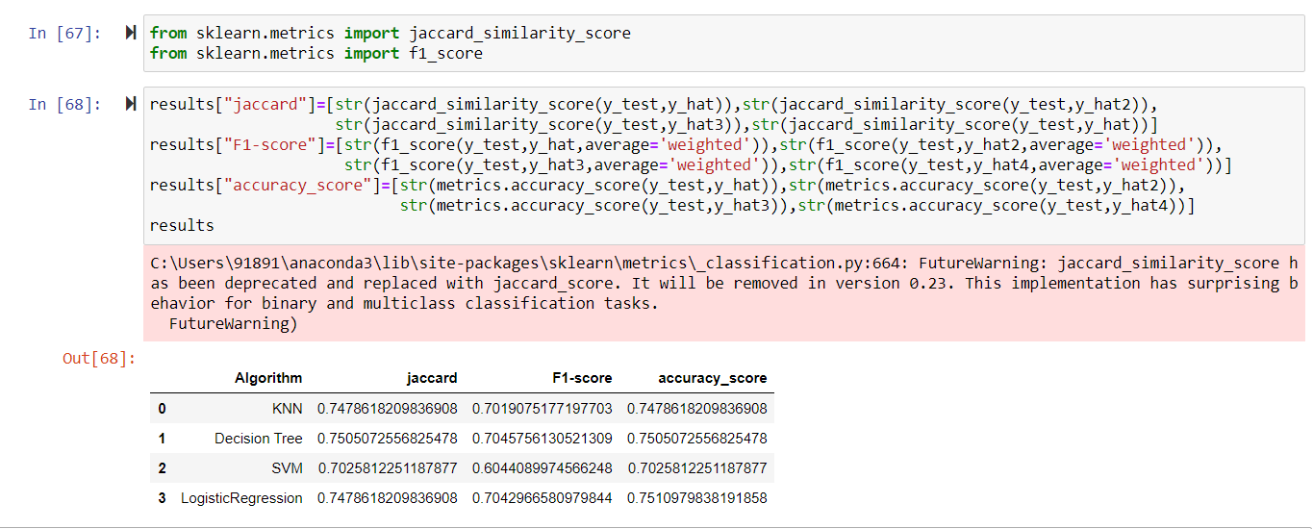
Results and Evaluations:

Slide 15
Conclusion
Based on historical data from weather conditions pointing to certain classes, we can conclude that particular weather conditions have a somewhat impact on whether or not travel could result in property damage (class 1) or injury (class 2).In terms of accuracy of SVM model and Decision Tree model are better but in terms of speed Logistic Regression is better

